Slide 1


MyPD - Arlington
Session : MyPD Application Features (iOS and Portal)
Audience : Arlington Project Team
Presenters : Andrew Evans

Slide 2
Application Modules
Social Channels
  Access APD Facebook, YouTube, and Twitter Feeds
  Open social media posts within the app
  Receive notifications for social media posts within the app
Reference Materials
  SharePoint Access - Review General/Special Orders, SOPs, and Training Materials posted on the APD’s SharePoint Online server from within the app
  Statutes - Open mobile-optimized versions of the State and City statutes websites within the app
  Citation Codes - Search and filter citation codes and view citation code details
  Shift Reports – Allows user to search and view daily shift reports of noteworthy/reportable incidents
Chief’s Blog
  Section available for Chief Johnson and the Media Office team to post blog messages available to the entire department
  Users can post comments and reply to the Chief’s blog posts
  Users can review the number of views to the blog posts
  The web portal is available for Blog Moderation. This includes editing a blog and comment moderation.
CAD
  Real-time map and of active calls and active police units displayed on scrollable map
  Detail view of ongoing 911 calls that include entries by dispatch and officers on scene
  Allows user to search for historical closed incidents by Call Number
Calendar
  View the APD Events Calendar
  Add events to your device calendar
Messaging
  Engage in individual and group chat with other MyPD users
  View online/offline status for contacts using the MyPD app.

Slide 3
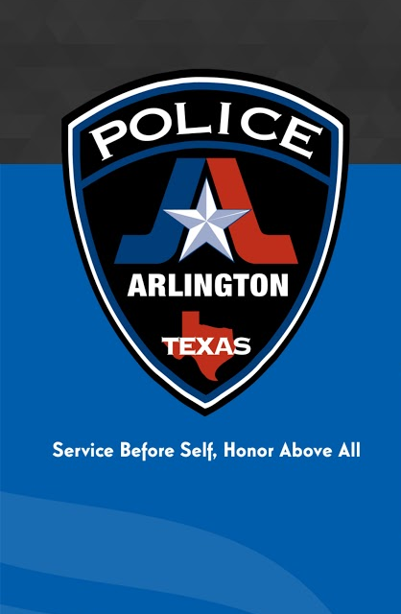
MyPD Permissions
The MyPD app uses 3Di’s MDM (Mobile Device Management) system to enable CJIS required controls that will allow 3Di Admin to lock or wipe a device (iOS) in the event it is lost and this activity is requested.
The MyPD app only tracks location for use in location based services provided by the app. This information is stored in a secure database. Neither 3Di staff nor APD has access to individual real time location data. Users also have the ability to disable location access when the app is not in use (achieved automatically through a setting in iOS), although this will disable certain location-based features, such as location based intelligence bulletin notifications.
The MyPD app does not have access to and does not transmit any local data on your device such as pictures or other files. Gallery access is only granted on a case-by-case basis when needed by the app, such as when adding a picture to a blog post or your user avatar. In these instances, only the picture selected by the user is uploaded by the app.

Slide 4
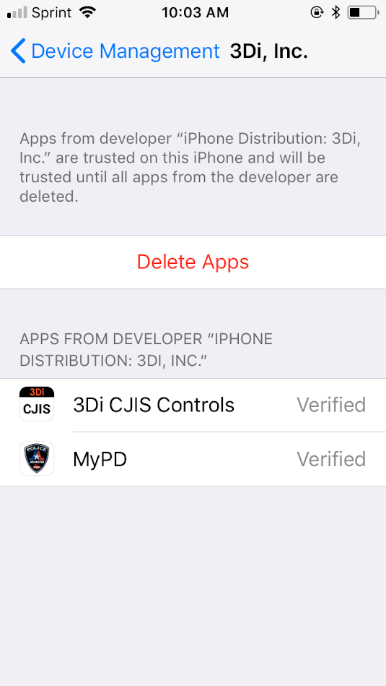
Installation – Trusted Developer
  Upon installation of the MyPD application and the CJIS Controls Enrollment application, you will be required to enable trusted developer settings on your iOS device before the application can be used.
  To enable trusted developer status, tap Settings > General > Profiles or Device Management.
  Under the "Enterprise App" heading, you will see a profile for 3Di, Inc.
  Tap the 3Di, Inc. button to open the profile settings and display the 3Di apps installed on your device. Tap on the Trust 3Di, Inc. button to establish trusted developer status for 3Di applications on your device.
  Once tapped, the Trust 3Di, Inc. button will change to Delete Apps, and will allow a one-tap uninstall option for all installed 3Di apps.

Slide 5
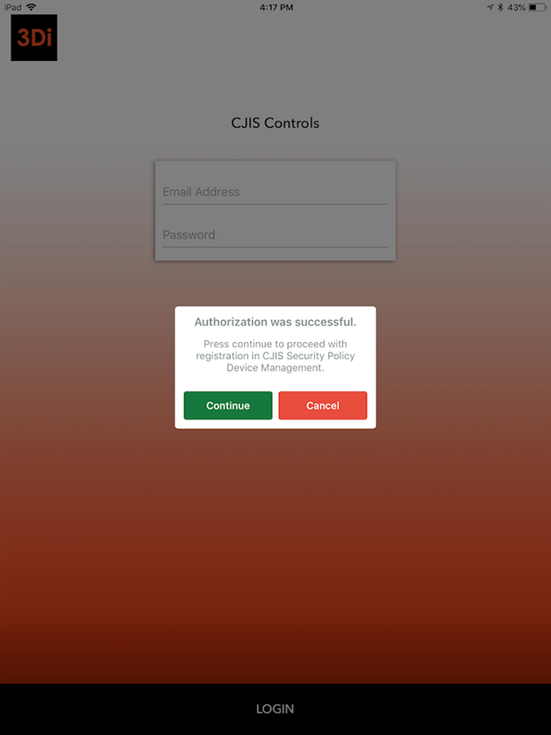
Login – CJIS Controls Enrollment
  On iOS devices, a CJIS Controls Enrollment application must be downloaded and opened prior to opening the MyPD application.
  The MyPD application enables CJIS compliance controls on your device that allow the device to be locked or to have your device wiped in the event that it is lost.
  During the initial installation process you will be required to enroll your device in the CJIS Controls Management.
  To enroll in CJIS Controls for your device, open the 3Di CJIS Controls application and enter your user name and password. When prompted, enter the one time passcode sent to your email.
  Upon entering valid credentials, you will get a prompt advising that Authorization was Successful. Press Continue to proceed to the enrollment screen.

Slide 6
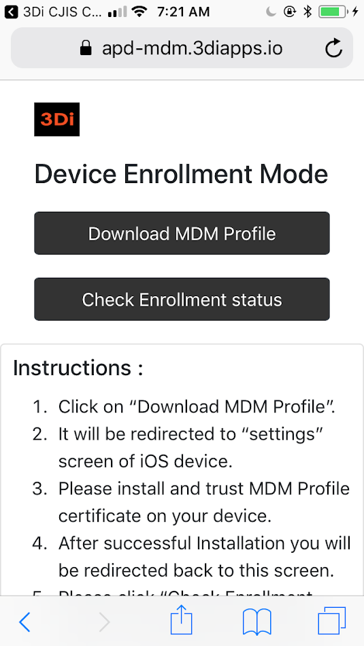
Login – CJIS Controls
  Upon reaching the enrollment screen, tap the Download MDM Profile button.
  You will be prompted to open your iOS device Settings and install the 3Di CJIS Controls profile. Click on Install/Trust when prompted to proceed.
  Once completed, click Done to return to the Device Enrollment screen and click on the verify enrollment status button. This will confirm that your device has enrolled successfully.
  Once enrollment is complete, open the MyPD application and enter your login credentials as normal.

Slide 7
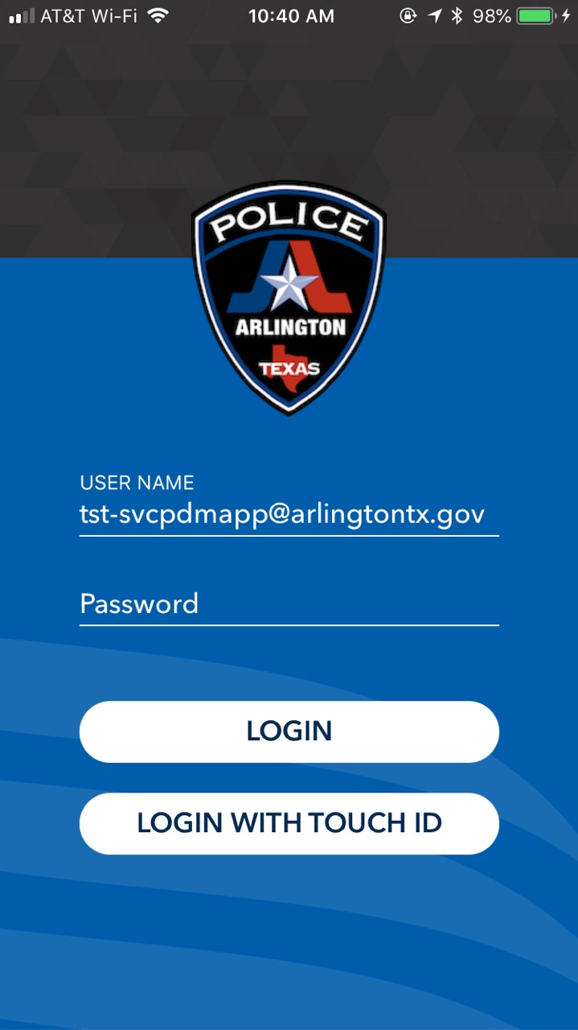
Login
  On the login screen, type in your city-assigned email address and password, and click the Login button.

Slide 8
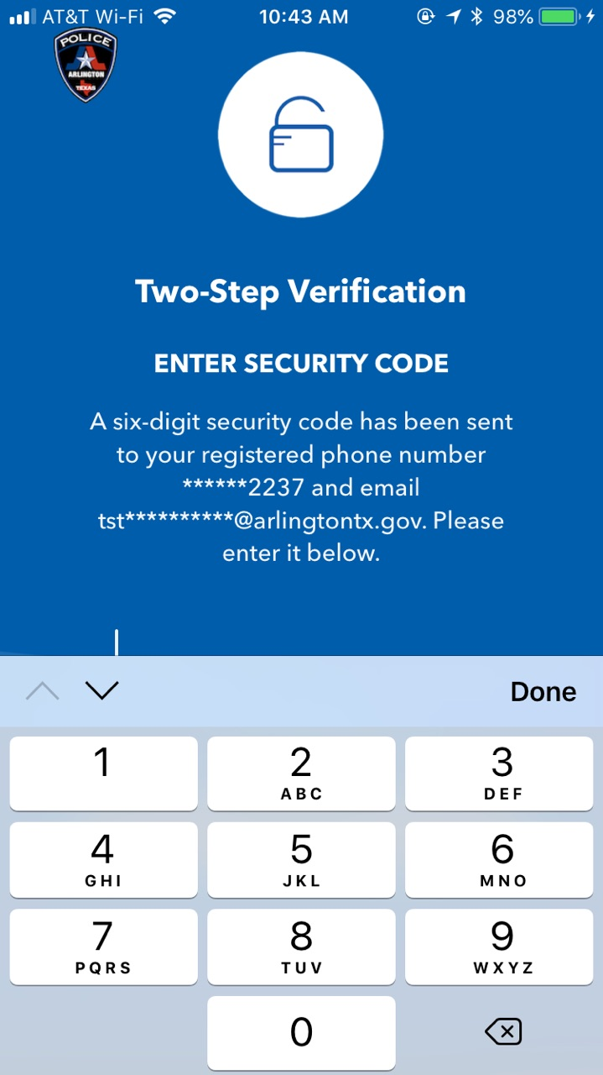
Login – Two Factor Authentication
  Upon entering your password, you will be prompted to enter a one-time code that will be sent to your city email and to the cell phone number registered to your account.
  Enter the one time code in the “Enter Code” field. This will authenticate you as the user who owns the account.
  If you did not receive the code, click on “Didn’t receive your code? Click here to resend it.”. The system will re-send a new code to your city email account and to your cell phone via SMS.

Slide 9
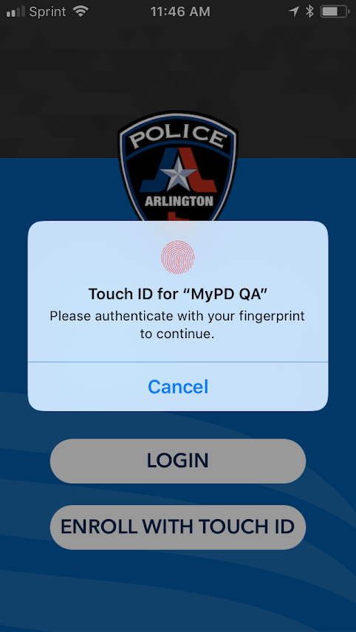
Login – TouchID Enrollment
  Take the following steps if you wish to use TouchID for future logins (and TouchID is supported by your device):
  Enter your city email address and password
  Click on “Enroll with TouchID”.
  You will be prompted to authenticate your fingerprint. Place your finger upon the Home Button on your device.
  Your fingerprint will now be associated to your account for future logins and you will be able to use TouchID in place of typing your email and password.

Slide 10
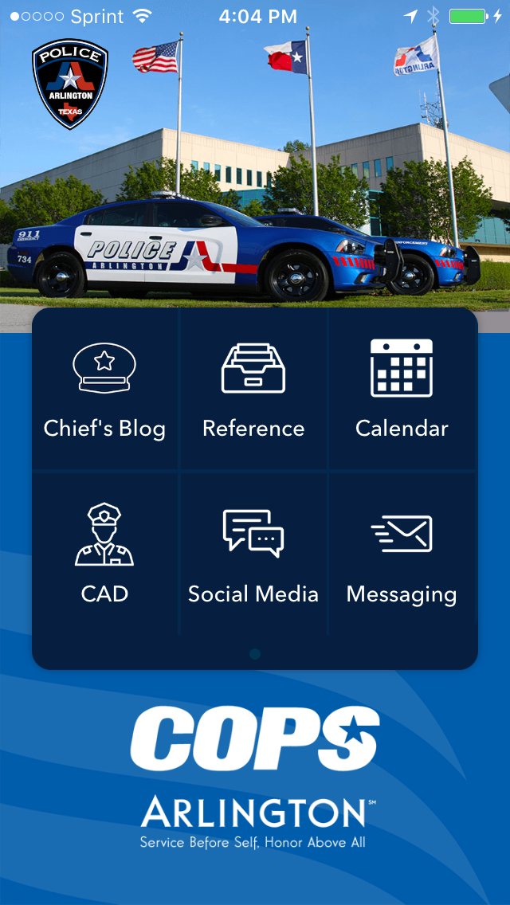
Navigation
  After login, you will be taken to the landing screen. This screen will list all of the modules available in the application.
  Chief’s Blog – a blog entered and maintained by Chief Johnson and the Media Office
  Reference Materials – access to SOPs, General/Special Orders, and Training Materials stored on SharePoint, in addition to Intelligence Bulletins, Shift Reports, Citation Codes, and Statutes
  Calendar – Events Calendar for the APD
  CAD – list of active 911 calls via list view and map view, as well as active unit status and closed incident detail
  Social Media – YouTube, Twitter, and Facebook feeds for APD
  Messaging – an in-app messaging and chat feature for 1 to 1 conversations and group chats

Slide 11
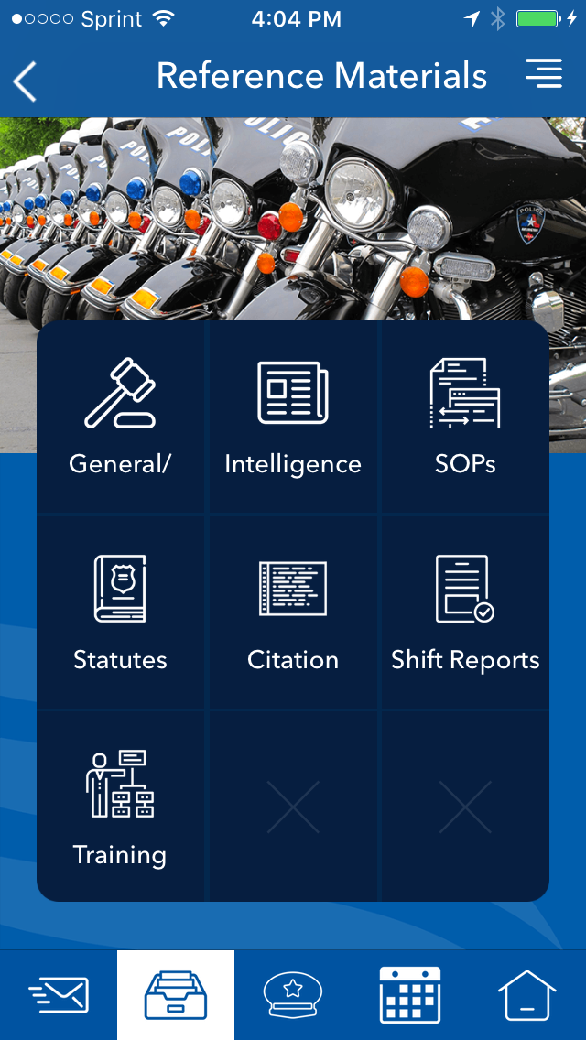
Navigation - Modules
  Clicking on a module will take you to that module.
  Some modules, such as Reference Materials, have multiple subsections. Clicking on Reference Materials will take you to the landing page for that section where you can select from different sub-modules.

Slide 12
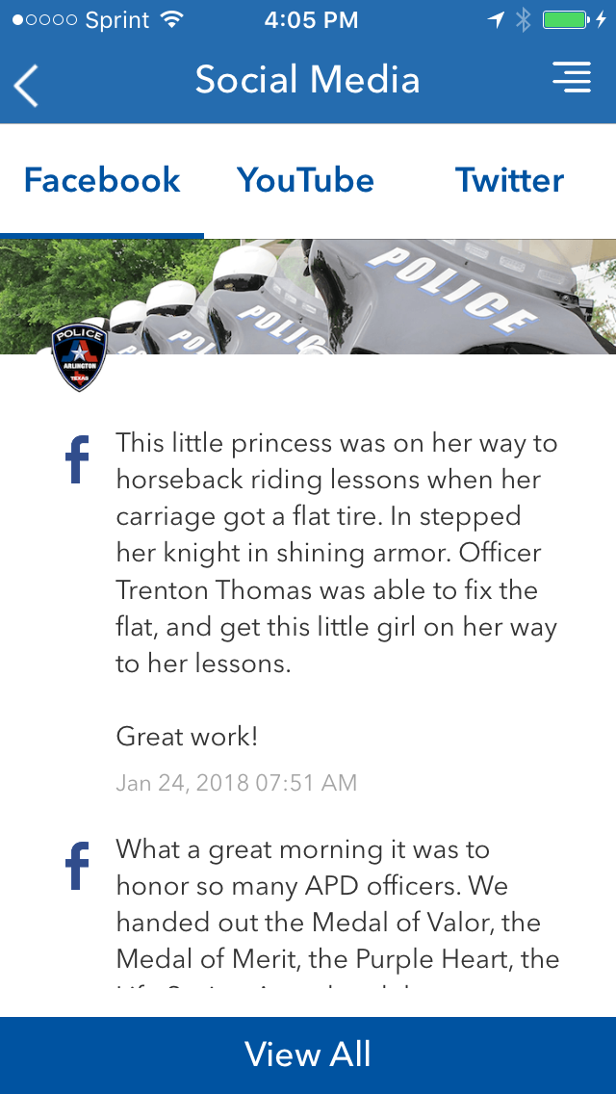
Social Media Feeds
From the landing page, click on Social Media to display the Arlington PD Facebook, Twitter, and YouTube feeds.
You can navigate between the feeds by clicking on the feed name at the top of the page.

Slide 13
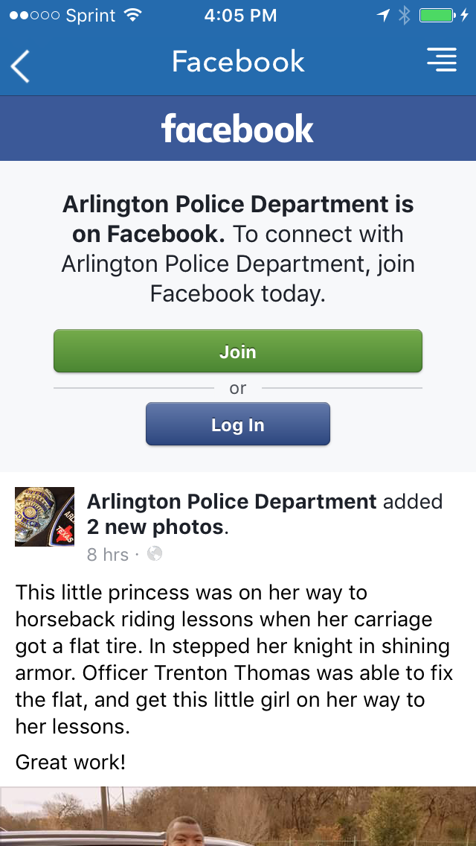
Social Media Feeds - Facebook
On the Facebook tab, scroll down to view the latest Facebook postings in chronological order.
To interact with a specific post, click on the post. The Facebook mobile page will load within the application.
Here, you can login with your Facebook account to interact with or reply to the Facebook post.

Slide 14
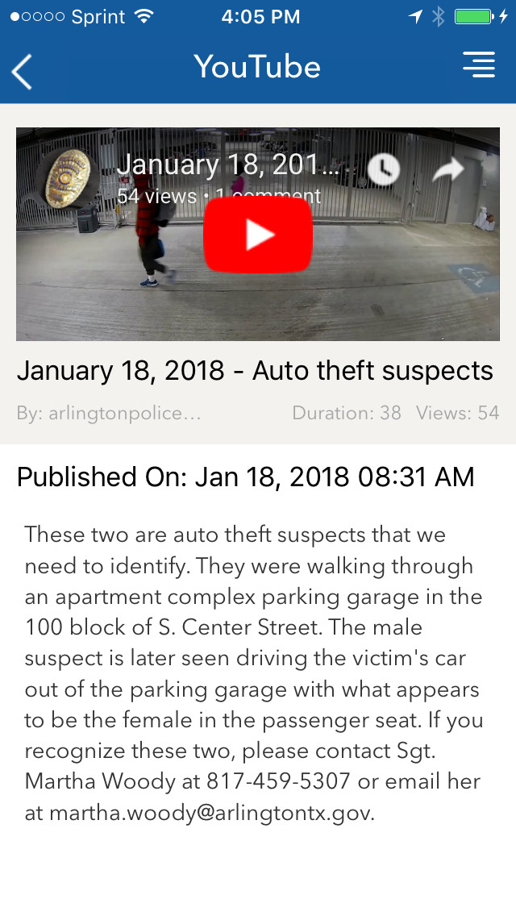
Social Media Feeds - YouTube
To view YouTube videos within the application, click on the YouTube tab and scroll down the list of YouTube videos (listed in chronological order by post date).
Click on a specific video post to load the details for a specific video and then click on the video itself for it to begin playing within the application.

Slide 15
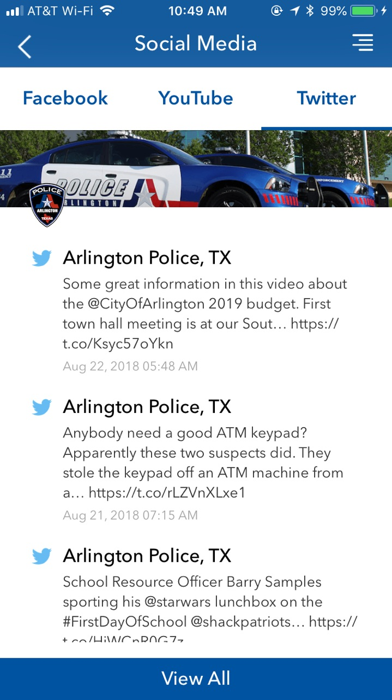
Social Media Feeds - Twitter
To load the Arlington PD Twitter feed, click on the Twitter tab and scroll through the latest tweets (in chronological order).
To interact with a specific tweet, click on it within the feed. The Twitter mobile page will load within the application. You can then login with your Twitter credentials to interact with or reply to the Tweet.
Note: the MyPD application shows only Tweets that have been directly posted by the @ArlingtonPD Twitter account. To view retweets that have been shared, tap on the View All button at the bottom of the window to load the Twitter mobile site within the app.

Slide 16
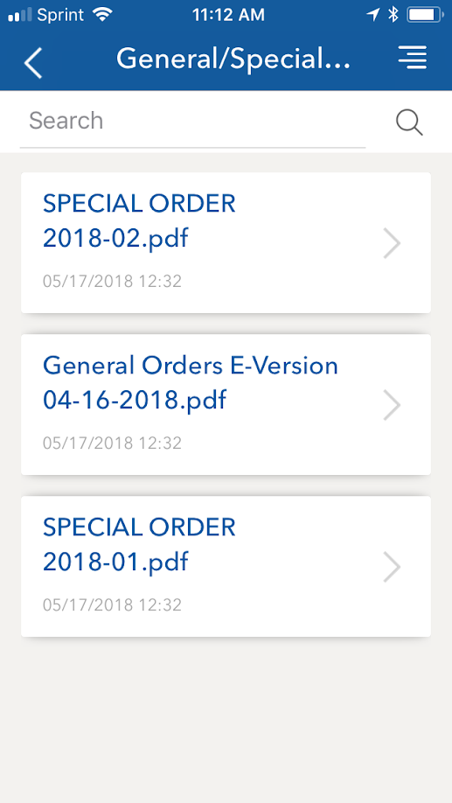
Reference Materials – SharePoint Documents
The following sections link to Arlington PD SharePoint Online folders:
General/Special Orders
SOPs (Standard Operating Procedures)
Training Materials
Files are listed in chronological order with the most current file in the folder shown first.
To display a file, click on the link within the window.
PDF files will be displayed within the application. Other file types, such as DOC, XLS, or PPT will prompt you to select the application you wish to use to open the file.
To search for a specific document or specific text within a document, type the search criteria in the search box and click the Search icon (magnifying glass). Documents with matching criteria will be displayed in the window below the search box.

Slide 17
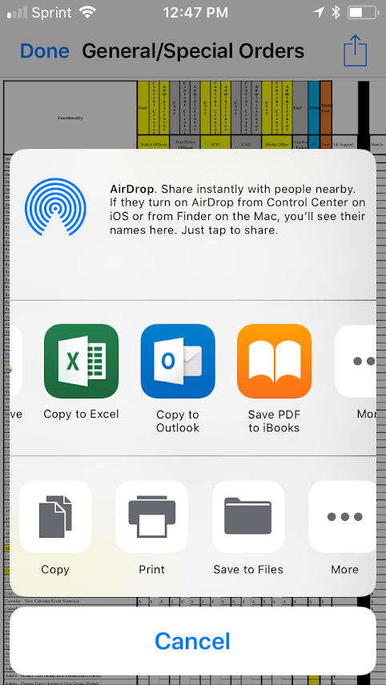

Reference Materials – SharePoint Documents
PDF, Word (DOC), Excel (XLS), or PowerPoint (PPT) files will be displayed as a preview in the application.
Using the button, you can choose to send the file to another application on your phone to be viewed in full, save the file to your device, send via email, or print.

Slide 18
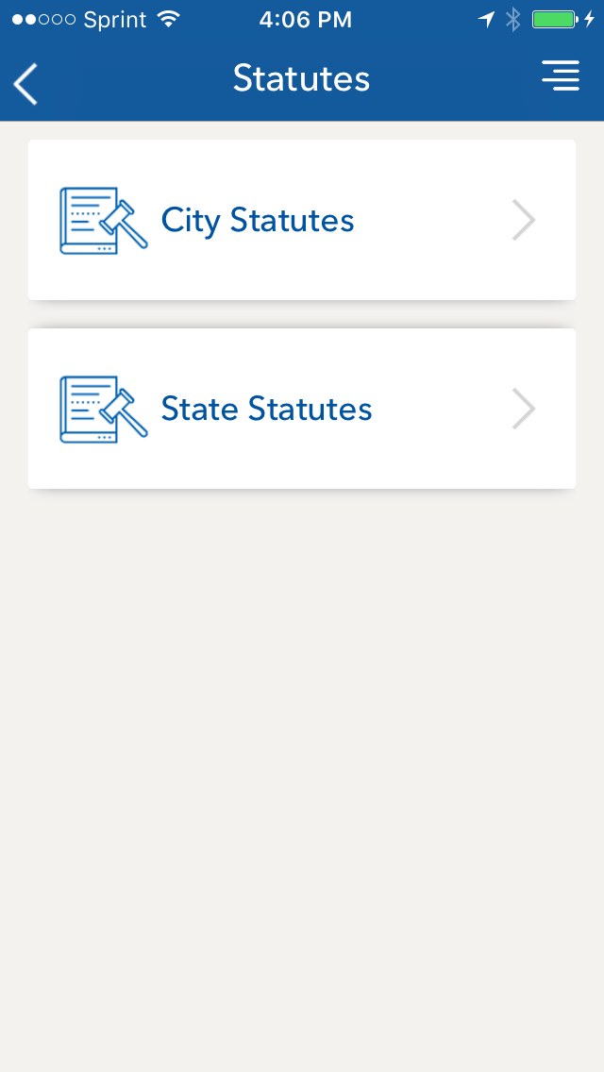
Reference Materials - Statutes
To search for city and state statute text within the app, click on the Reference Materials module and the Statutes submodule.
Links to both the City website and the State website will be listed. Clicking on the City Statutes or State Statutes link will load the city or state website within the application and will allow for statute data to be searched.

Slide 19
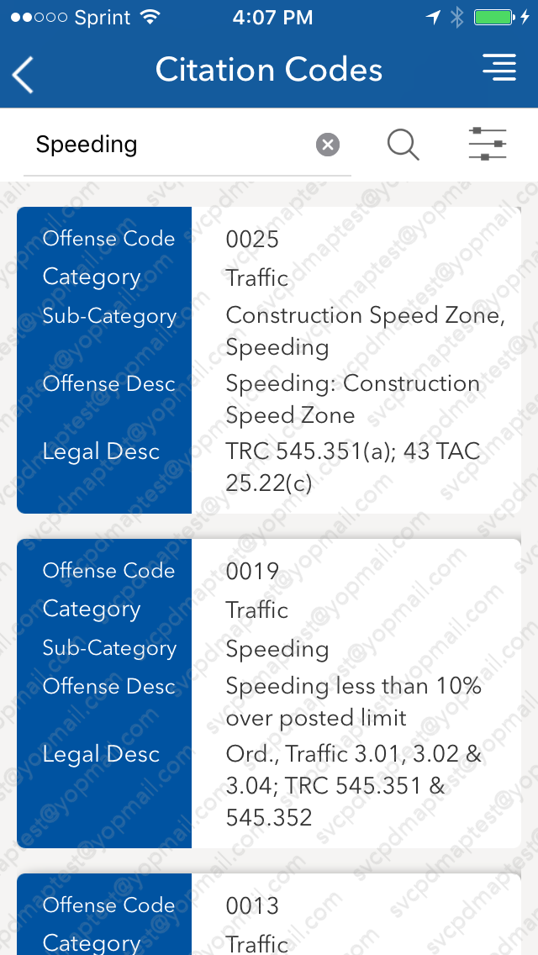
Reference Materials – Citation Codes
To search for Citation Code details, click on the Reference Materials module and then click on the Citation Codes sub-module.
The search screen will be displayed, which will allow the user to search for Citation Codes by keyword (Category, Subcategory or Description) or by offense code.

Slide 20
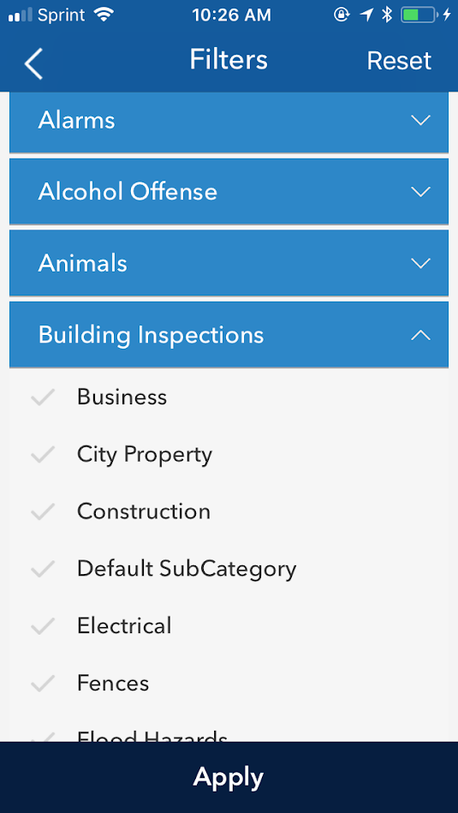
Reference Materials – Citation Codes
Citation Codes can be filtered by Category and Sub-Category by clicking on the filter button.
Click on the different categories to display the sub-categories for that citation code type.
To display codes within a certain category or sub-category, click the check-box next to the applicable sub-categories and click “Apply”.

Slide 21
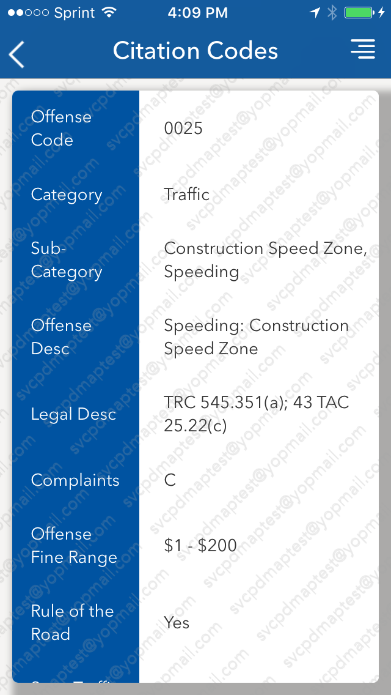
Reference Materials – Citation Codes
To display the detail of a specific citation code, click on the card once search results or filtered results are displayed.
The Citation Code detail will be displayed showing additional information for the selected citation code.

Slide 22
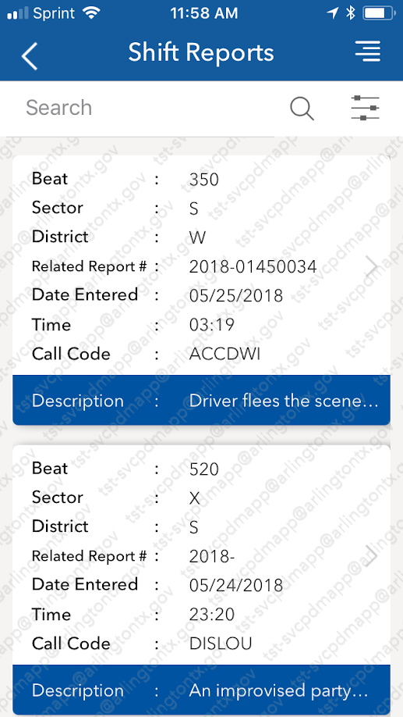
Reference Materials – Shift Reports
To search for Shift Report records, click on the Reference Materials module and then click on the Shift Reports sub-module. The Shift Reports list view will be displayed. This will list the Shift Reports in chronological order with the most recent displayed at top.
To search for a specific report or based on specific criteria, type the query in the Search box and click the search button. To filter by District, Beat, or by date of the report, click on the Filter button.
To view a report in detail, click on the info card listing the report you wish to display.

Slide 23
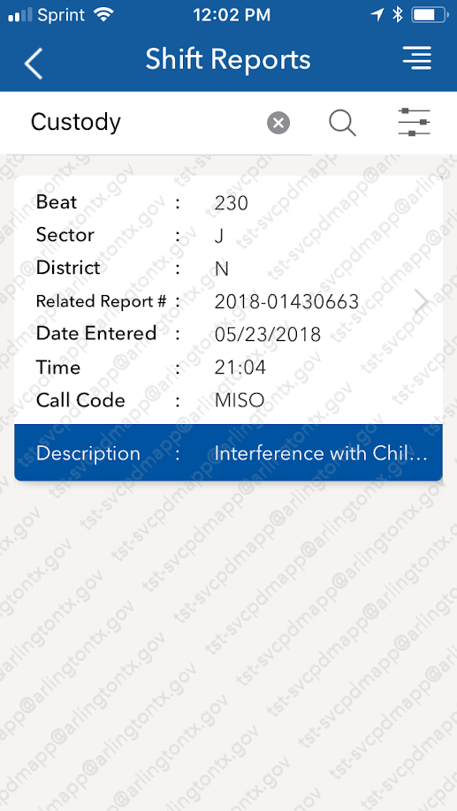
Reference Materials – Shift Reports
The search box searches the entire report and all fields for a matching entry. To initiate a search, type in the word or number that you wish to search for, and click the Search button (the magnifying glass icon).
This will return the search results in the lower half of the screen.
The search box will search for text in any field, including Beat, Related Report Number, Call Code, or Description.

Slide 24
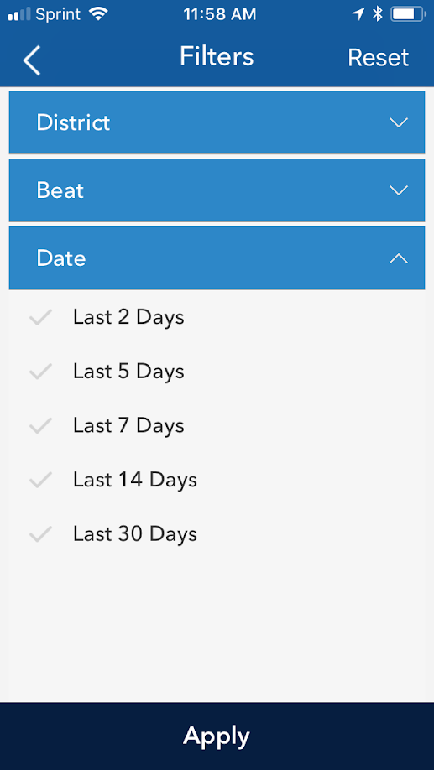
Reference Materials – Shift Reports
The filter screen allows the ability to filter Shift Reports by specific criteria, such as District, Beat, and Date Entered.
To filter, click the arrow button on the field you wish to Filter (District, Beat, Date Entered) to expand the list and select the value to filter. Once you have selected all criteria, click the Apply button at the bottom of the screen.
This will update the results on the List view to display results based on the filtered criteria.

Slide 25
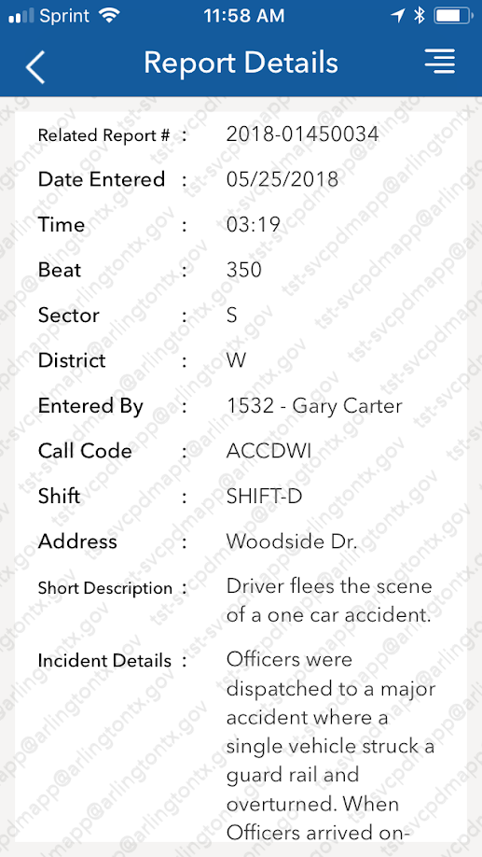
Reference Materials – Shift Reports
The detail view will show the report in full, and includes the following data:
Date and Time
Related Report Number
Shift on which the incident occurred
Beat, Sector and District
Name of the user who entered the report
Call Code
Address where the incident occurred
Short description
Incident details.

Slide 26
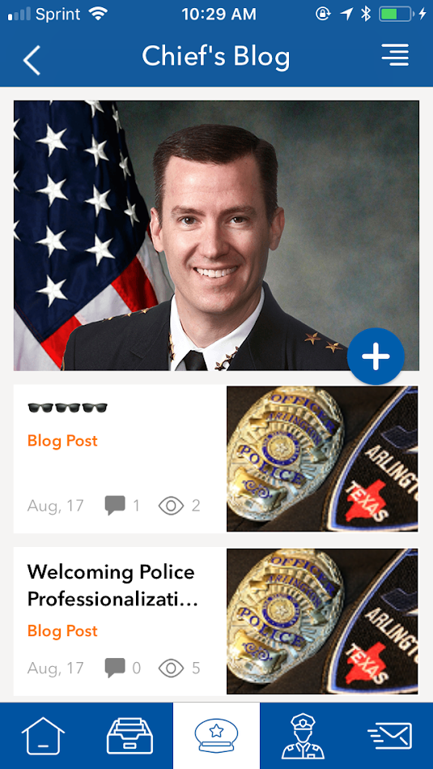
Chief’s Blog – Viewing Blog Posts
By clicking on the Chief’s Blog link from the landing page, the user will be presented with a list of blog posts posted by Chief Johnson in chronological order.
Click on the post to view a blog posting in detail.
Media Office users and the Chief can add additional blog posts by clicking the Add Blog button (the blue and white plus icon) located on the Blog list screen.

Slide 27
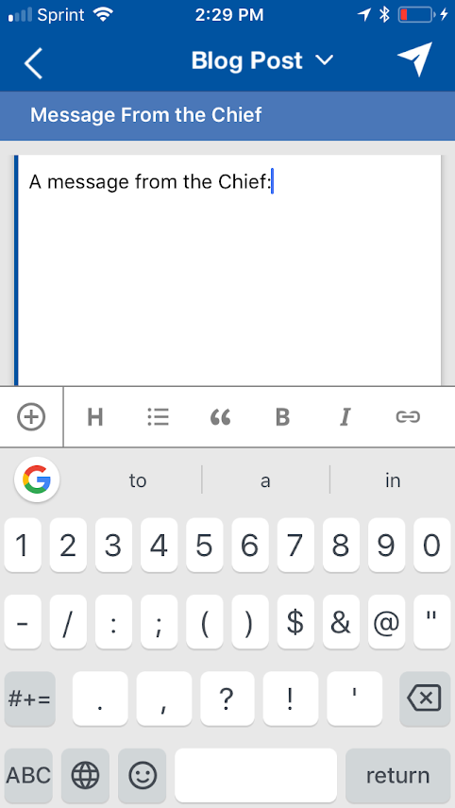
Chief’s Blog – Add Blog Posts
When the Add Blog button is selected, the Blog draft page will be displayed. A category can be selected of either a standard Blog Post, a Chief’s Coin post, or a wRap Sheet post.
Text can be modified and URL links can be added by clicking the applicable text icon on the bottom bar. Text can be bolded, italicized, and underlined.
Images can be added by selecting the Plus button at the left of the Edit bar and selecting “Capture Media” or “Select From Library”.
By clicking the back button, a blog post can be saved for later posting. The user will be returned to the Blog List.
To post the blog, click on the Post button in the top right hand corner of the screen.

Slide 28
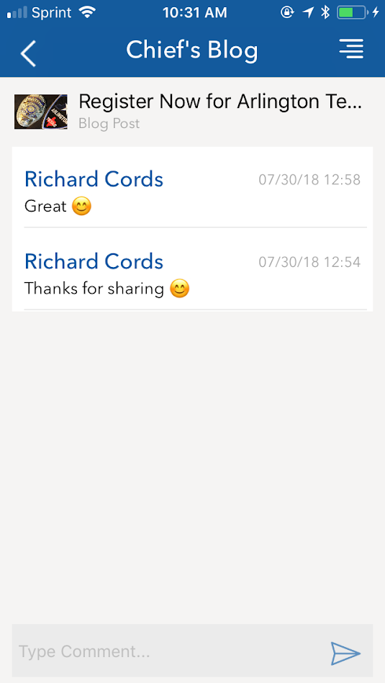
Chief’s Blog – Add Comments
To add a comment to a blog post, click on the Comments link in the Blog detail.
Enter comment text at the bottom of the screen in the “Type Comment” field.
Comments will be auto approved as long as they don’t contain any profanity.

Slide 29
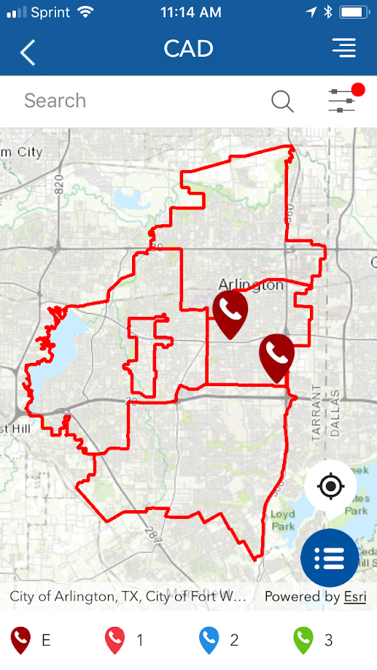
CAD – Map View (Active Calls/Units)
To view the CAD module, select CAD from the landing page after logging into the app.
The Map view will be displayed , divided by Sector. The map will display the current active 911 calls and police units as of the time the module was loaded, indicated by a Call or Unit icon on the map. The legend for call priority is displayed at the bottom of the screen.
To view a summary of information on a call or unit, tap on the Call or Unit icon on the map. To load the detail view, tap on the summary card.
To search for a specific call or unit, enter the Call Number or Unit ID into the search box and tap on the search icon (magnifying glass). To filter the map results, tap on the filter button. Calls and Units can be filtered Call Type , Unit Status, and Priority (Calls Only).
To zoom in to your current location, tap the compass icon in the bottom right hand corner of the map.
To display the calls in List view format, select the List view button in the bottom right hand corner of the screen. This will display the Active Calls as info cards that provide greater detail.

Slide 30
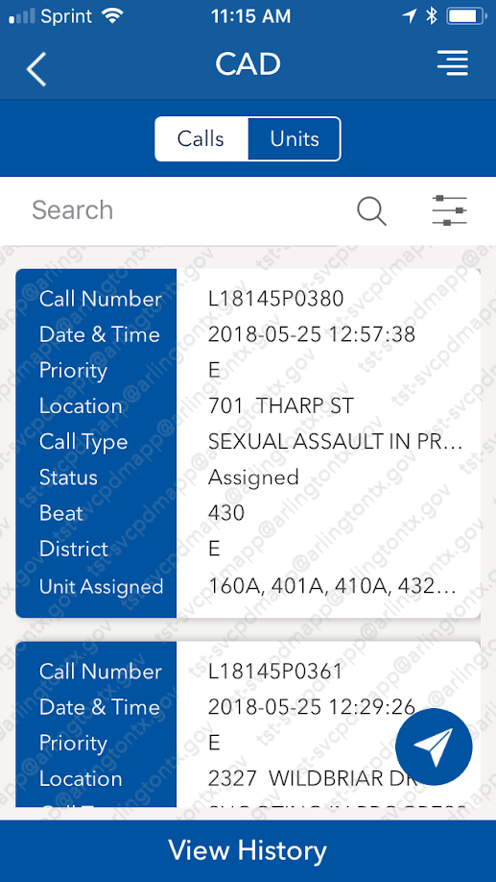
CAD – List View
The List view will display the Active Calls by default in chronological order. To switch between Active Calls and Active Units, tap on the appropriate tab at the top of the screen.
For Active Calls, the summary of each call is displayed on an information card. The fields displayed are Call Number, Date & Time, Priority, Call Type, Status, Beat, District, Unit Assigned, and Cross Street.
For Active Units, the information card will display Unit ID, Vehicle ID, Officer ID, Officer Name, Unit Status, Location, Call Type, and Call Number.
To view the Detail view for the Call listed or that the unit is assigned to, tap on the information card.
To search for a specific call or unit, enter the Call Number or Unit ID into the search box and tap on the search icon (magnifying glass). To filter the results, tap on the filter button. Calls and Units can be filtered Call Type , Unit Status, and Priority (Calls Only).
To view Closed Calls/Historical Incidents, tap on the View History button at the bottom of the screen.

Slide 31
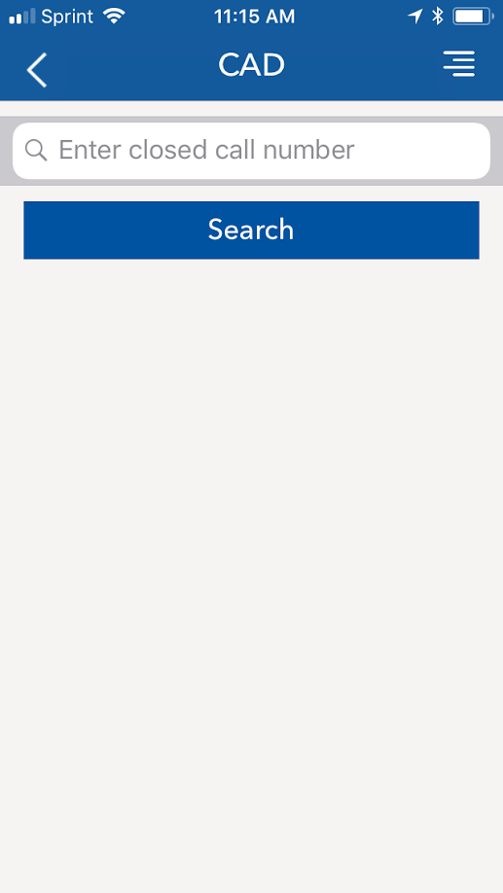
CAD – Closed Calls
The Closed Calls function allows the user to search for calls that are no longer active. From the View History screen, type in the Call Number for the call that you wish to search and tap the Search button.
To locate a result, the Call Number must be typed in full. Partial entries will not return a result.
Upon entering the Call Number, the Call Details screen will be displayed for the call that was queried.

Slide 32
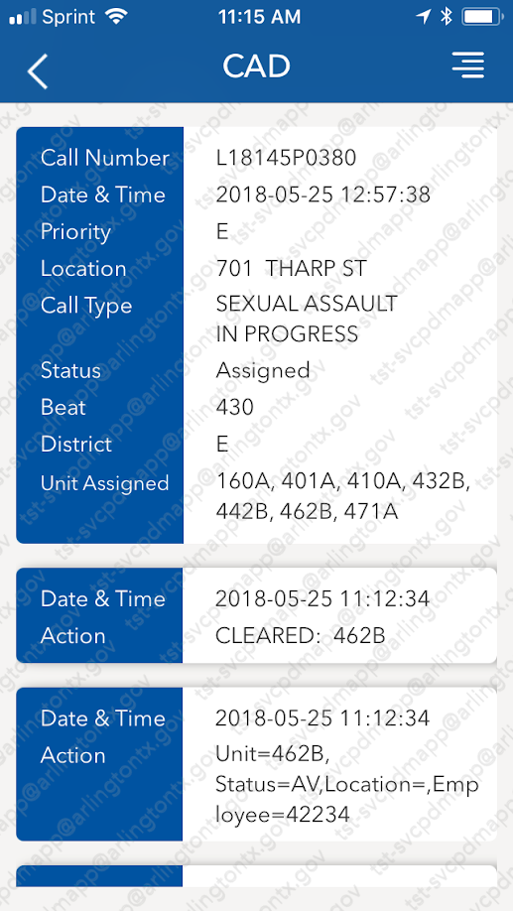
CAD – Call Detail
When an information card is tapped on the Map or List View, or when a Call Number is entered from the Closed Calls view, the Call Detail will be displayed for the call that was entered or selected. Tapping on a Unit information card in Map or List View will display the Call that the Unit is assigned to (if they are actively assigned).
The detail view will display all of the information visible in List/Map View, and will also display the Detail information that is entered in by dispatch and by the Officer on their in-unit CAD display.
To view the information, scroll down through each of the messages. The messages are displayed in chronological order.
To return to the prior screen, tap the back button in the top left hand corner.

Slide 33
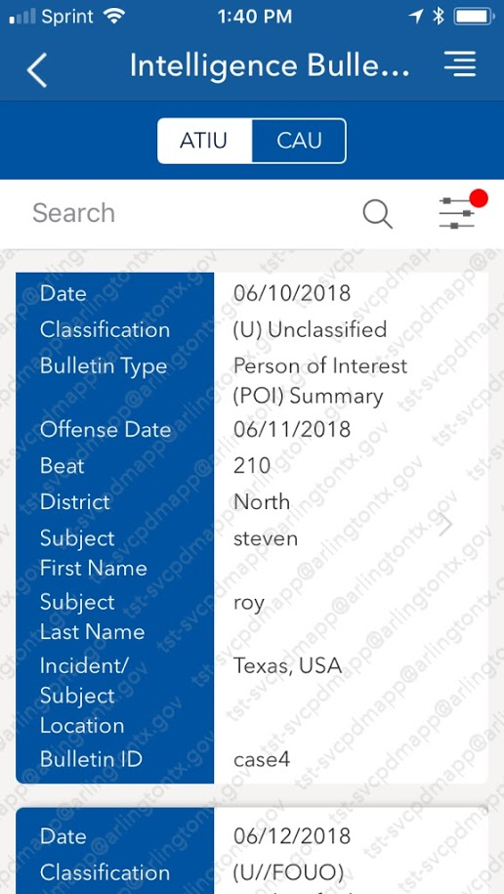
Intelligence Bulletins (ATIU) - Search
To access the ATIU bulletins, tap on the Reference Materials module from the landing page and select Intelligence Bulletins. The bulletin search window will be displayed.
To search for ATIU bulletins, type in the bulletin ID, subject name, or location in the Search box and tap enter.
Bulletin results will show the following metadata: Date (Entry Date), Classification, Bulletin Type, Offense Date, Beat, District, Subject First/Last Name, Incident/Subject Location, Bulletin ID
To view the bulletin in PDF format, tap on the information card of the bulletin you wish to view.
Note: the PDF will be opened within the application. It cannot be downloaded to your device.

Slide 34
Intelligence Bulletins - Notifications
A push notification will be sent to your device when you are within range of the location specified on the information card.
Tapping on the push notification in your notification bar will open the app and take you to the relevant bulletin for that location.

Slide 35
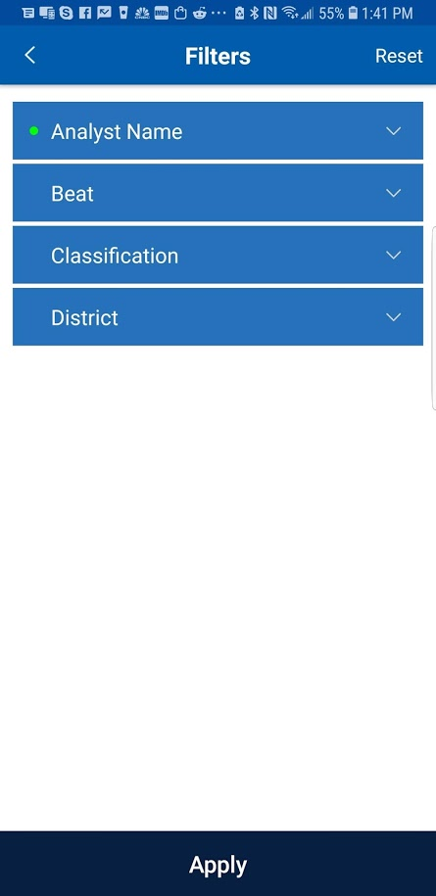
MyPD App – Intelligence Bulletins (ATIU) - Filter
Bulletins can be filtered by the following metadata fields:
Analyst Name
Beat
District
Classification
To filter the results, click on the filter button located on the search screen, select the filter criteria and click Apply.
The search results will be amended to display bulletins with the matching criteria.

Slide 36
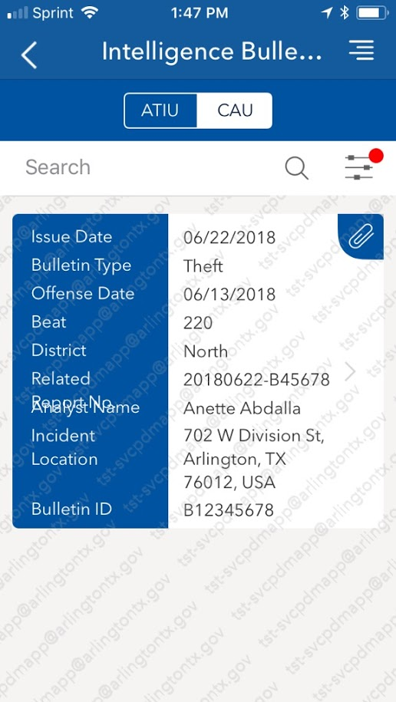
Intelligence Bulletins (CAU) - Search
To access the CAU bulletins in the app, tap on the Reference Materials module from the landing page and select Intelligence Bulletins. The bulletin search window will be displayed.
To search for CAU bulletins, tap on the CAU option in the selector button at the top of the search window, type in the bulletin ID, related report number, or location in the Search box and tap enter.
Bulletin results will show the following metadata: Issue Date, Classification, Bulletin Type, Offense Date, Beat, District, Analyst Name, Incident Location, Bulletin ID
To view the bulletin in PDF format, tap on the information card of the bulletin you wish to view.
Note: the PDF will be opened within the application. It cannot be downloaded to your device.

Slide 37
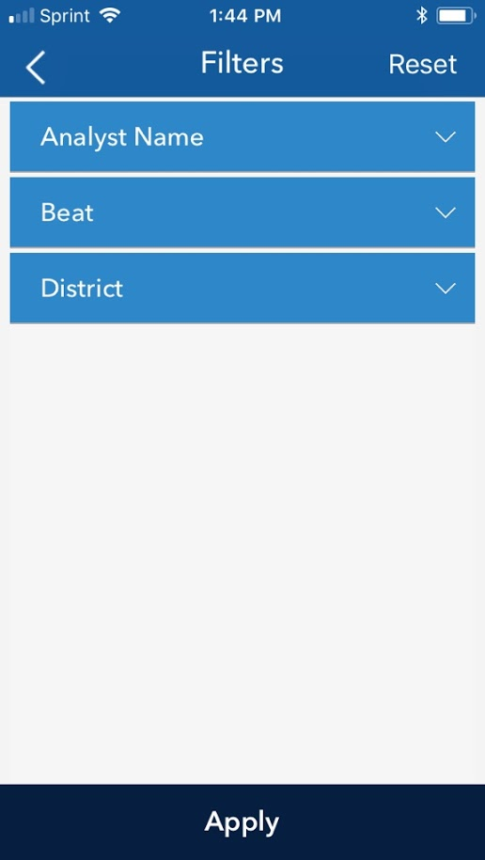
MyPD App – Intelligence Bulletins (CAU) - Filter
Bulletins can be filtered by the following metadata fields:
Analyst Name
Beat
District
Classification
To filter the results, click on the filter button located on the search screen, select the filter criteria and click Apply.
The search results will be amended to display bulletins with the matching criteria.

Slide 38
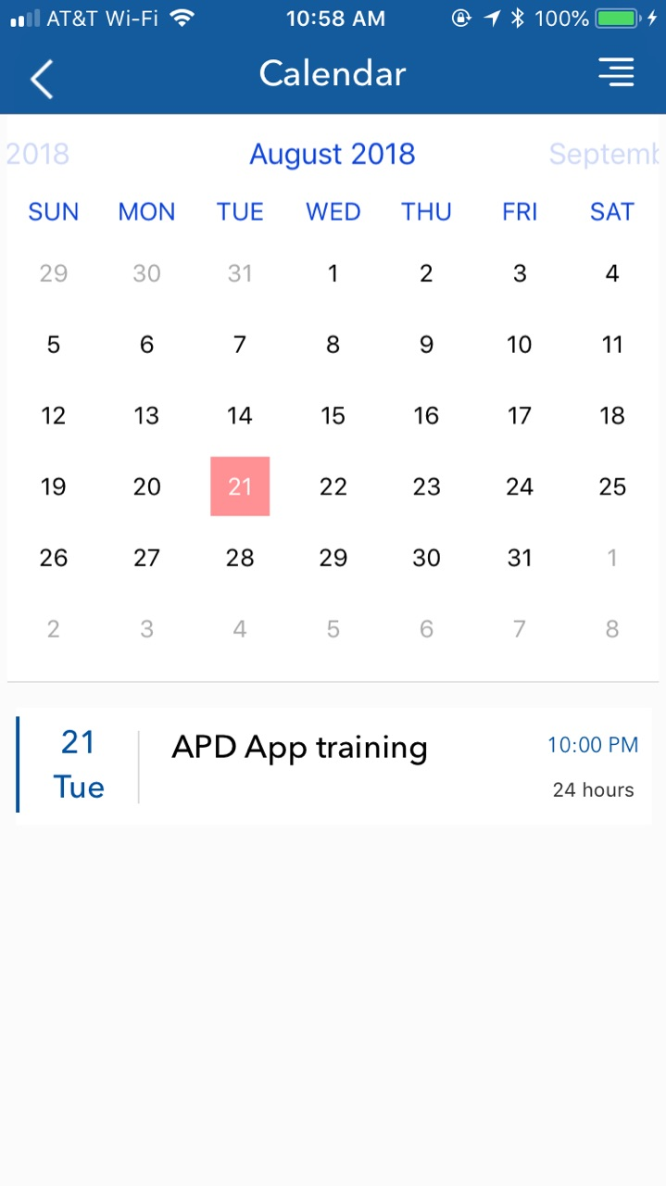
MyPD App – Calendar
The Arlington PD Events Calendar can be accessed by clicking the Calendar button on the landing screen.
This will display the events calendar with the current month in view.
A list of events for the current month’s view will be displayed in the bottom half of the screen.
To view a specific date, click on the date in the calendar view in the top half of the screen. Dates with event entries will be highlighted in red.
To view a specific event detail, click on the event in the bottom half of the screen. This will load the event detail view.
To view previous or future months, swipe to the left or right in the calendar view on the top half of the screen. (Note: Only current and future events will be visible.)

Slide 39
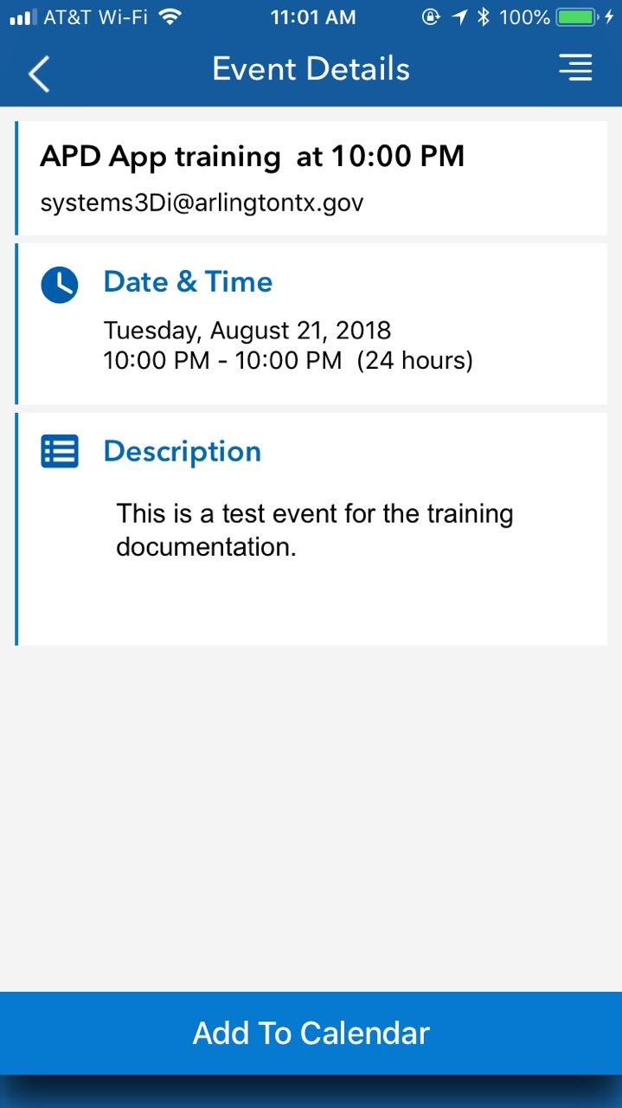
MyPD App – Calendar Detail
The Event Detail screen will display the event description, the date and time of the event, the location (if entered), and a list of attendees.
To add the event to your device calendar, click on the “Add to Calendar” button at the bottom of the screen.

Slide 40
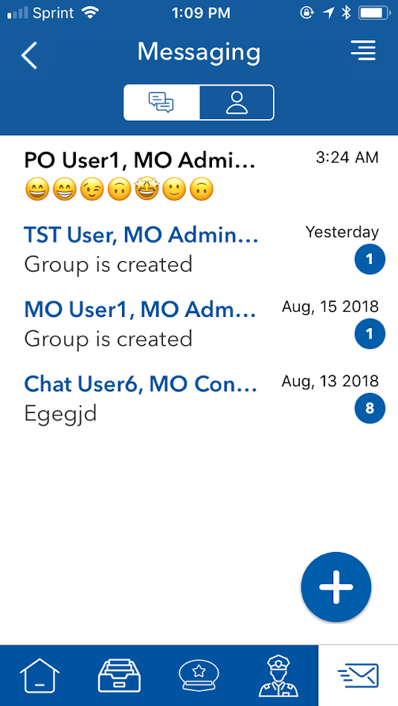
MyPD App – Messaging – Messages/Chat Tab
The Messaging module allows for chat between individuals and groups within the MyPD application.
Upon loading the Messaging module, a list of active messages and chats a displayed. A list of Users can be displayed by tapping the Users tab.
Each message or chat will be displayed with the following information:
name of the user(s) OR name of the chat group,
Preview of the last message received/sent
Time of the last message
Notification badge with the number of new messages
To initiate a new conversation, tap the New Chat button in the bottom right corner of the window.

Slide 41
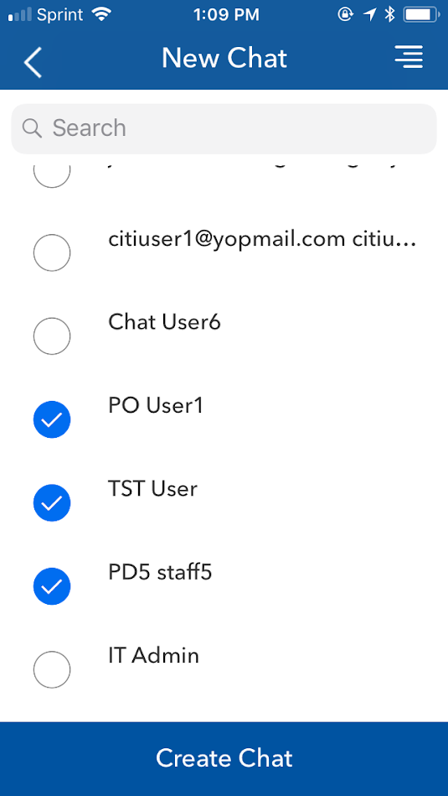
MyPD App – Messaging – New Chat
In the New Chat window, you can search for and select the user(s) who you wish to add to your chat.
Type the user name in the search box. You may search for a full or partial name.
Tap on the user’s name to add them to the chat room. To add more than one user, tap multiple names. A checkbox will appear next to each name selected.
Click on Create Chat

Slide 42
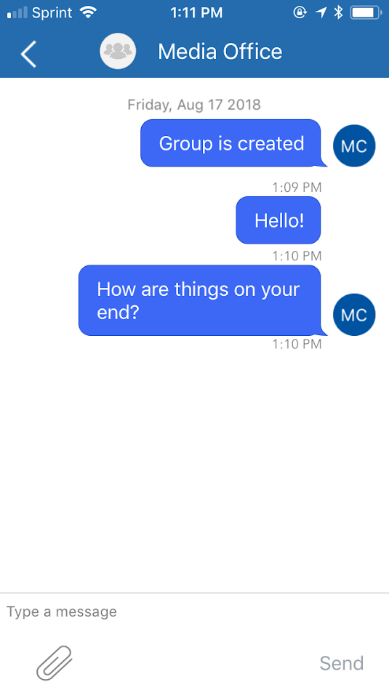
MyPD App – Messaging – Chat
In the Chat screen, messages sent by other users will be displayed in a white text box, with the name of the user referenced above the text. Messages sent by yourself will be shown in a blue text box on the right side of the window.
A message can be sent to the specified user by typing in the Message bar at the bottom of the screen and hitting the enter button or tapping on the Send key.
Users may also include picture attachments by tapping on the Attachment icon in the left side of the Message bar. Select Use Existing to choose an existing picture from your device gallery, or select Take Photo to take a new picture with your device camera.
To modify the chat settings, tap on the name of the chat shown at the top of the screen (the default chat name will be the names of the chat participants).

Slide 43
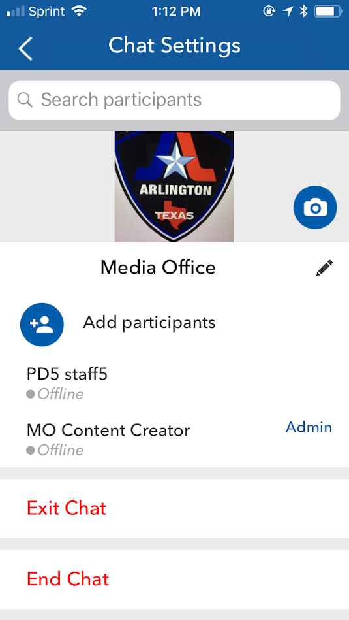
MyPD App – Messaging – Chat Settings
On the Chat Settings screen, users can search for a user that is participating in the chat by typing the user’s name in the Search Participants box and tapping on the search icon. The user information and their online status will be displayed below.
Administrative users can take the following actions on the Chat Settings screen:
Add Chat Room Image – click on the photo icon to select an image icon for the chat room. The image icon will be displayed as a thumbnail at the top of the screen next to the chat name.
Change Chat Name – click on the edit icon next to the chatroom name. The default name will be the names of the chat participants.
Add Participants – to add additional participants, tap on the Add Participants and search for the user to be added. Tap on the user and press the Done key to add the user to the chat.
Make Admin/Remove From Group – tap and hold on a user name in the participants list to make the user an admin, remove admin status, or remove the user from the group.
Exit Chat – click on Exit Chat to leave the chat group. Note: the chat must have at least one other admin in order for the admin user to be able to leave the chat.
End Chat – This will close the chat for all users.

Slide 44
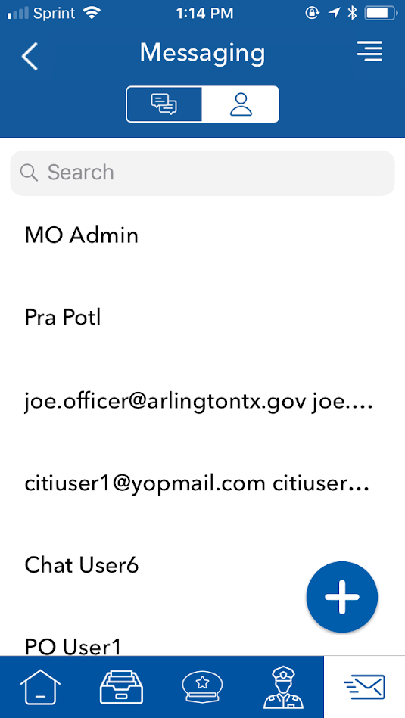
MyPD App – Messaging – Contacts Tab
The contacts tab will allow you to search for a user, view their online status, and initiate a conversation.
To search for a specific user, type their name into the search box and click on the search button. A list of matching users will be displayed.
After searching for a specific user, you can begin a message by tapping on the user’s name and entering a message in the message box.

Slide 45
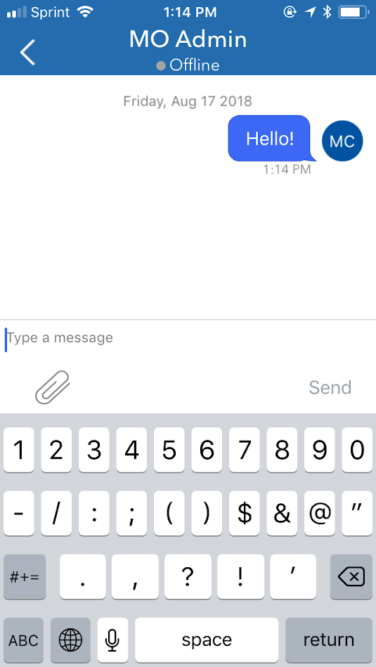
MyPD App – Messaging – Message
When a new message is started from the Contact Tab, the message window will display.
The name of the user and their online/offline status will be reflected at the top of the window.
A message can be sent to the specified user by typing in the Message bar at the bottom of the screen and hitting the enter button or tapping on the Send key.
As in a chat window, Users may also include picture attachments by tapping on the Attachment icon in the left side of the Message bar. Select Gallery to choose an existing picture from your device gallery, or select Camera to take a new picture with your device camera.
Messages sent by the user will display on the right side in a blue text box, while messages received by the user will display on the left side in a grey text box.

Slide 46
MyPD Web Portal Features
Note: ATIU and CAU Units

Slide 47
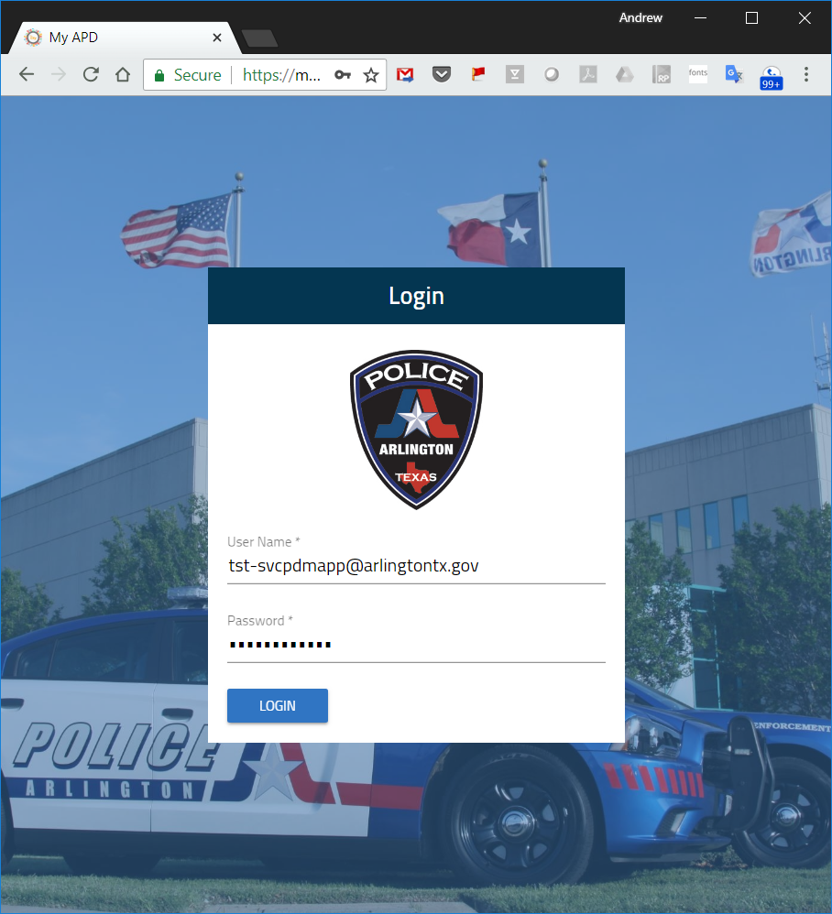
MyPD Portal - Login
The MyPD Portal can also be used to view police dashboards, view Blog posts, and manage comments posted to blog content, as well as administrative functions.
To log into the portal, open the Portal URL and enter the same credentials used for login into the mobile app: https://myapd.arlingtontx.gov
A one time passcode will be emailed to you (and sent via SMS if your phone is registered to your account). This code must be entered in order to continue login.

Slide 48
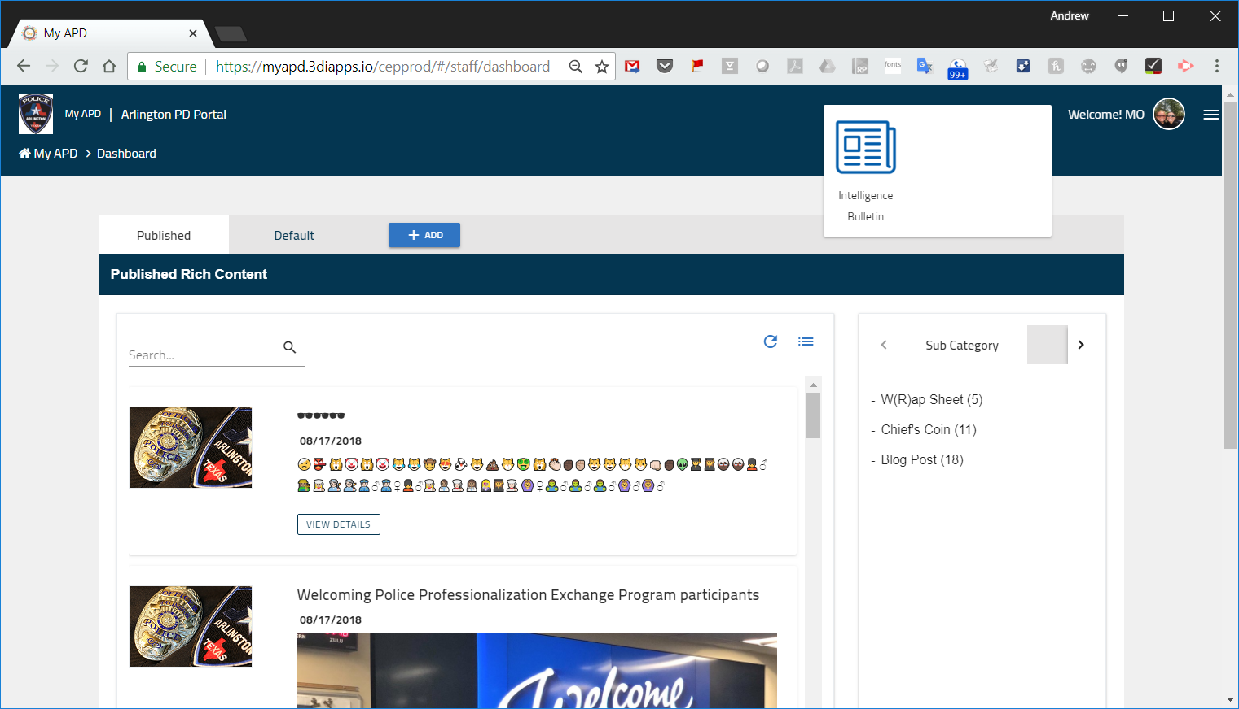
Intelligence Bulletins – Portal Access
To access the Intelligence Bulletins application module on the portal, follow the instructions below:
Login to the MyPD Portal:
  Production: https://myapd.3diapps.io/cepprod
  QA: https://apdqa.3diapps.io/cepqa/
Click on the application module launcher at the top of the screen to the left of your user name and then click on the “Intelligence Bulletins” app
The application module will load. Click on the Hamburger menu in the top right corner of the screen and then select “Intelligence Bulletins”
Click on the APD module and select Intelligence Bulletins, then click the appropriate team whose bulletins you wish to manage (ATIU or CAU).
Menu
Application Module Launcher

Slide 49
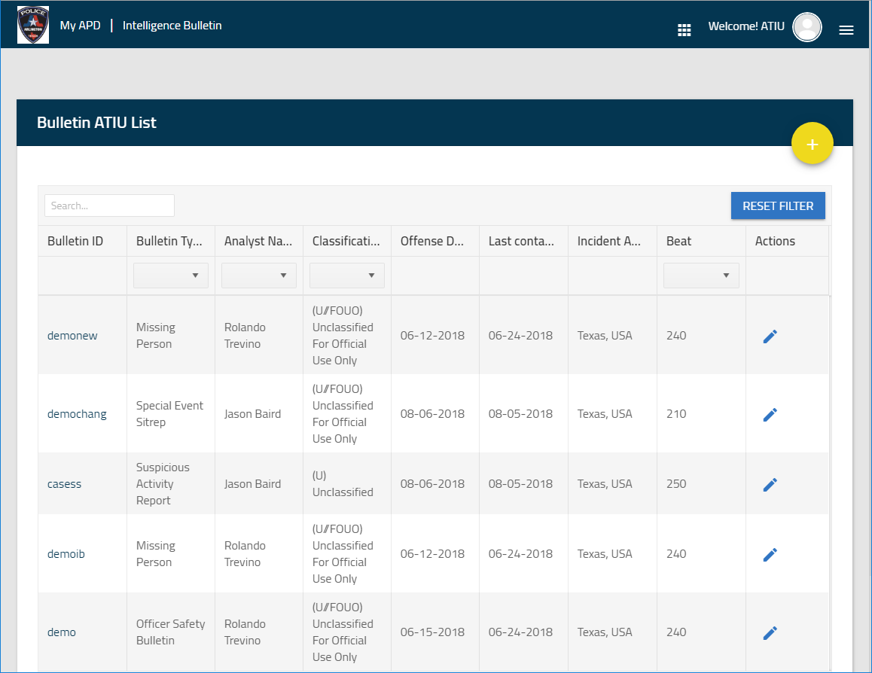
Intelligence Bulletins (ATIU) – Web Portal/Upload
After clicking on the ATIU Management link, the Bulletin List View will be displayed. The list view shows the uploaded bulletins in chronological order with the most recent at the top.
Bulletins can be sorted by Offense Date or Last Contact Date by clicking on the column header at the top.
Bulletins can be searched by typing the query for Bulletin ID into the text box at the top left of the screen and entering a full or partial match.
Bulletins can be filtered by Bulletin Type, Analyst Name, Classification and Beat.
To change the number of bulletins displayed by default, change the value in the “items per page” dropdown.
To create a bulletin, click on the add bulletin button in the top right hand corner of the screen.

Slide 50
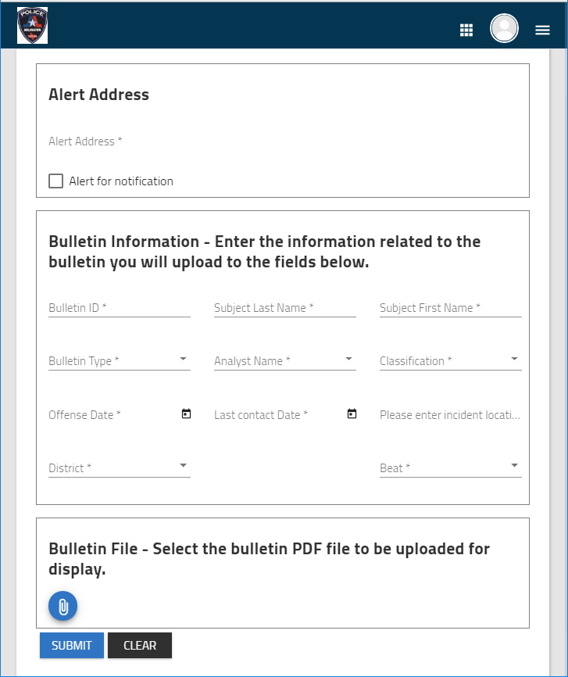
Intelligence Bulletins (ATIU) –Upload
The ATIU bulletin creation screen will display the metadata fields required to upload the bulletin. This page can only be accessed by an ATIU Analyst or Administrator.
To upload the bulletin, the following fields must be completed:
Alert Address – The address location used to display the push notification. For this function to work, the Alert for Notification box must be checked.
Bulletin ID – unique identifier for the bulletin.
Subject Last Name/First Name – name of the subject for whom the bulletin applies
Bulletin Type – category of bulletin that is being uploaded, ex. Officer Safety Bulletin
Analyst Name – Name of the ATIU analyst who created the bulletin
Classification – security classification that will determine who can access the bulletin
Offense Date/Last Contact Date – date of the offense in question and the last contact date with the subject
Incident Location – address or general location of the subject/incident
District / Beat – Area and section of the city where the subject/incident is located
To upload the PDF, click on the paperclip icon and select the PDF file from your hard drive. To submit the bulletin, click on the submit button.

Slide 51
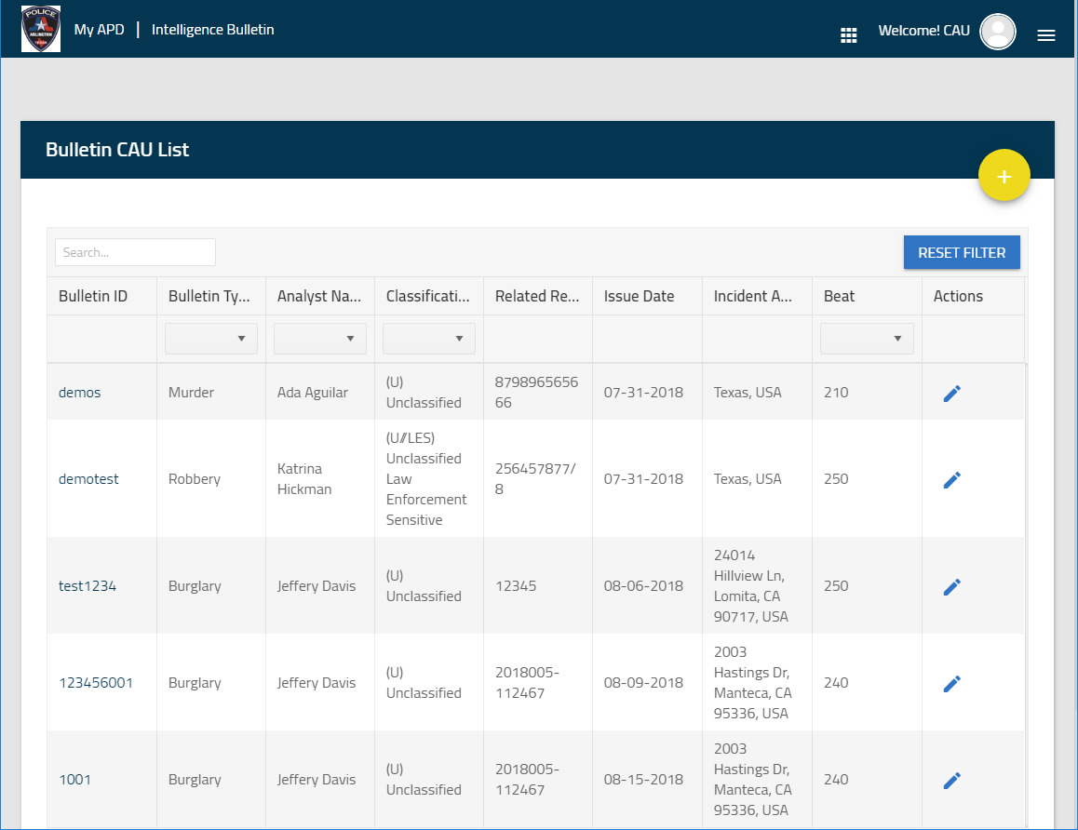
Intelligence Bulletins (CAU) – Web Portal/Upload
After clicking on the CAU Management link, the Bulletin List View will be displayed. The list view shows the uploaded bulletins in chronological order with the most recent at the top.
Bulletins can be sorted by Issue Date or Address by clicking on the column header at the top. You can switch between chronological/alphabetical ascending and descending with each click of the column.
Bulletins can be searched by typing the query for Bulletin ID into the text box at the top left of the screen and entering a full or partial match. This will modify the list to change the matching filters.
Bulletins can be filtered by Bulletin Type, Analyst Name, Classification and Beat.
To create a bulletin, click on the add bulletin button in the top right hand corner of the screen.

Slide 52
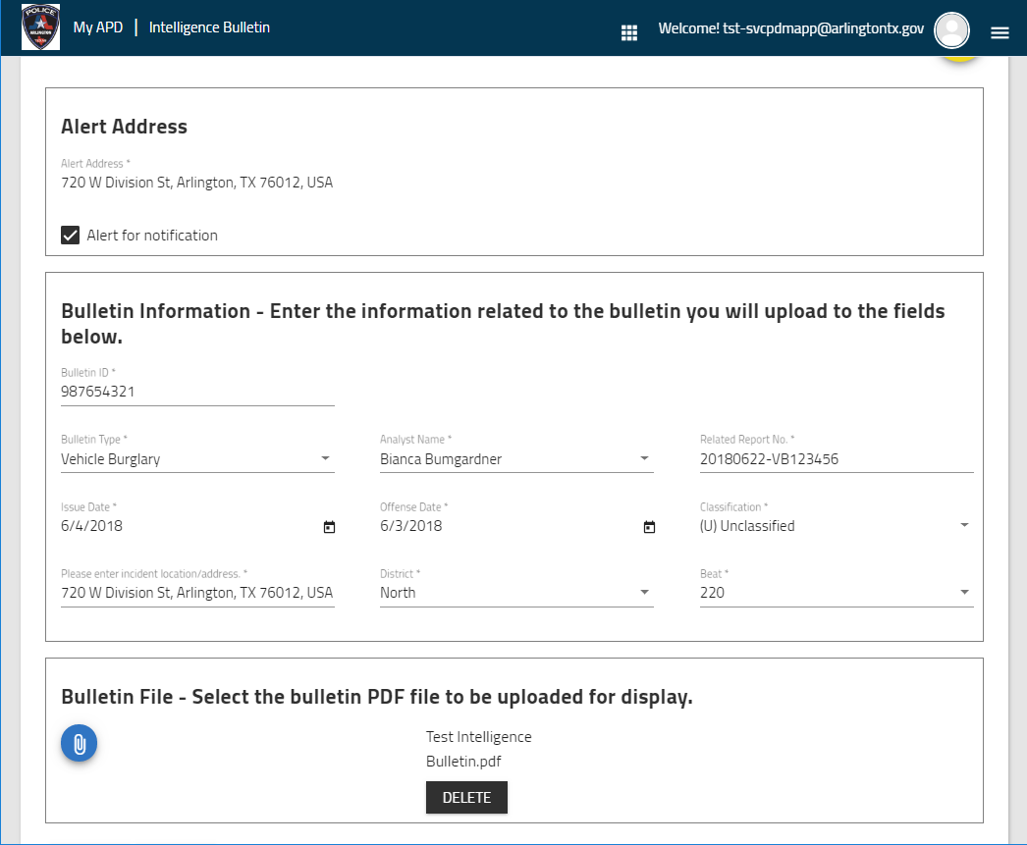
Intelligence Bulletins (CAU) –Upload
The CAU bulletin creation screen will display the metadata fields required to upload the bulletin. This page can only be accessed by an CAU Analyst or Administrator. To upload the bulletin, the following fields must be completed:
Alert Address – The address location used to display the push notification. For this function to work, the Alert for Notification box must be checked.
Bulletin ID – unique identifier for the bulletin.
Related Report No. – report number for any crime or shift report related to the bulletin in question
Bulletin Type – crime category of bulletin that is being uploaded, ex. Burglary
Analyst Name – Name of the CAU analyst who created the bulletin
Classification – security classification that will determine who can access the bulletin
Offense Date/Issue Date – date of the offense in question and the date the bulletin was issued
Incident Location – address or general location of the subject/incident
District / Beat – Area and section of the city where the subject/incident is located
To upload the PDF, click on the paperclip icon and select the PDF file from your hard drive. To submit the bulletin, click on the submit button.

